Slide 1
RETAIL ANALYTICS CAPSTONE PROJECT
- ABIR GHOSH

Slide 2
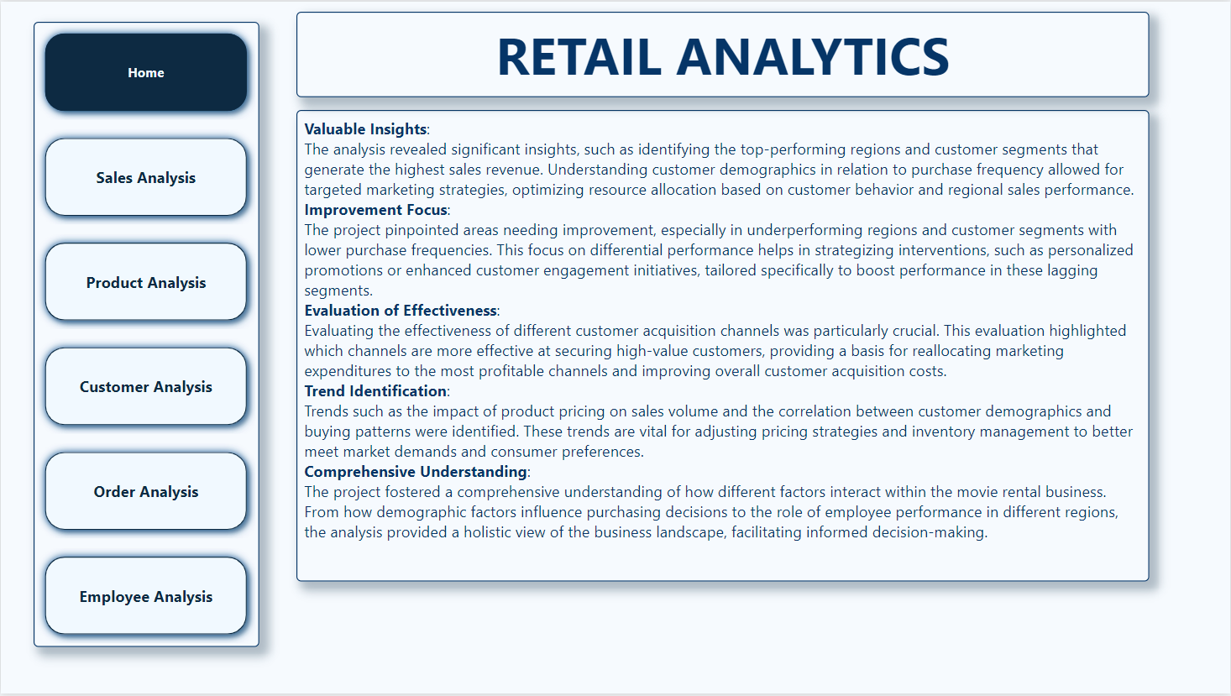

Slide 3



Objective: The primary objective of this project was to leverage retail data to enhance decision-making and optimize operational strategies in the retail sector. By analyzing customer behaviors, sales performances, and product trends, the project aimed to streamline inventory management, enhance customer satisfaction, and boost sales performance.
Analysis Scope: The scope of the analysis encompassed comprehensive examination of sales data, customer demographics, product performance, and employee contributions. Focusing on customer acquisition channels, purchase frequencies, regional sales distributions, and product profitability, the analysis aimed to cover all critical elements that influence retail business outcomes.
Goal: The goal of this project was to derive actionable insights that could significantly improve operational efficiency and profitability in the retail environment. This included enhancing customer engagement strategies, optimizing marketing efforts, and refining stock levels to meet consumer demand effectively.

Slide 4



Insights and Recommendation: Insights from the analysis highlighted several opportunities for improvement, such as optimizing marketing campaigns to target profitable customer segments and adjusting inventory based on sales trends and customer preferences. Recommendations were also made to enhance the layout and deployment of promotional materials based on high-traffic areas and peak shopping times identified in the data.
Report and Presentation: The comprehensive report detailed all findings and strategic recommendations, supported by robust data visualizations and statistical evidence from the analysis. The presentation effectively communicated these insights to stakeholders, providing a clear roadmap for implementing recommended changes.
The Power BI Dashboard: A dynamic Power BI dashboard was developed to facilitate ongoing monitoring and analysis within the retail business. It features interactive visualization tools that allow stakeholders to track real-time performance metrics, understand market trends, and assess the effectiveness of implemented strategies across various business dimensions.

Slide 5
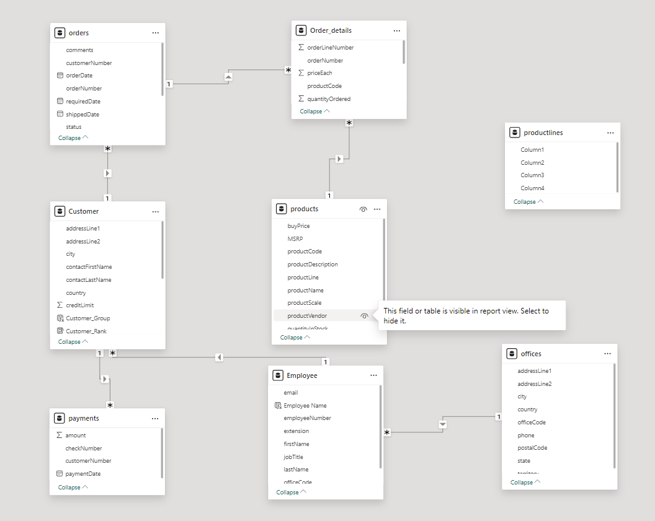

Slide 6
POWER BI PROBLEM STATEMENTS

Slide 7
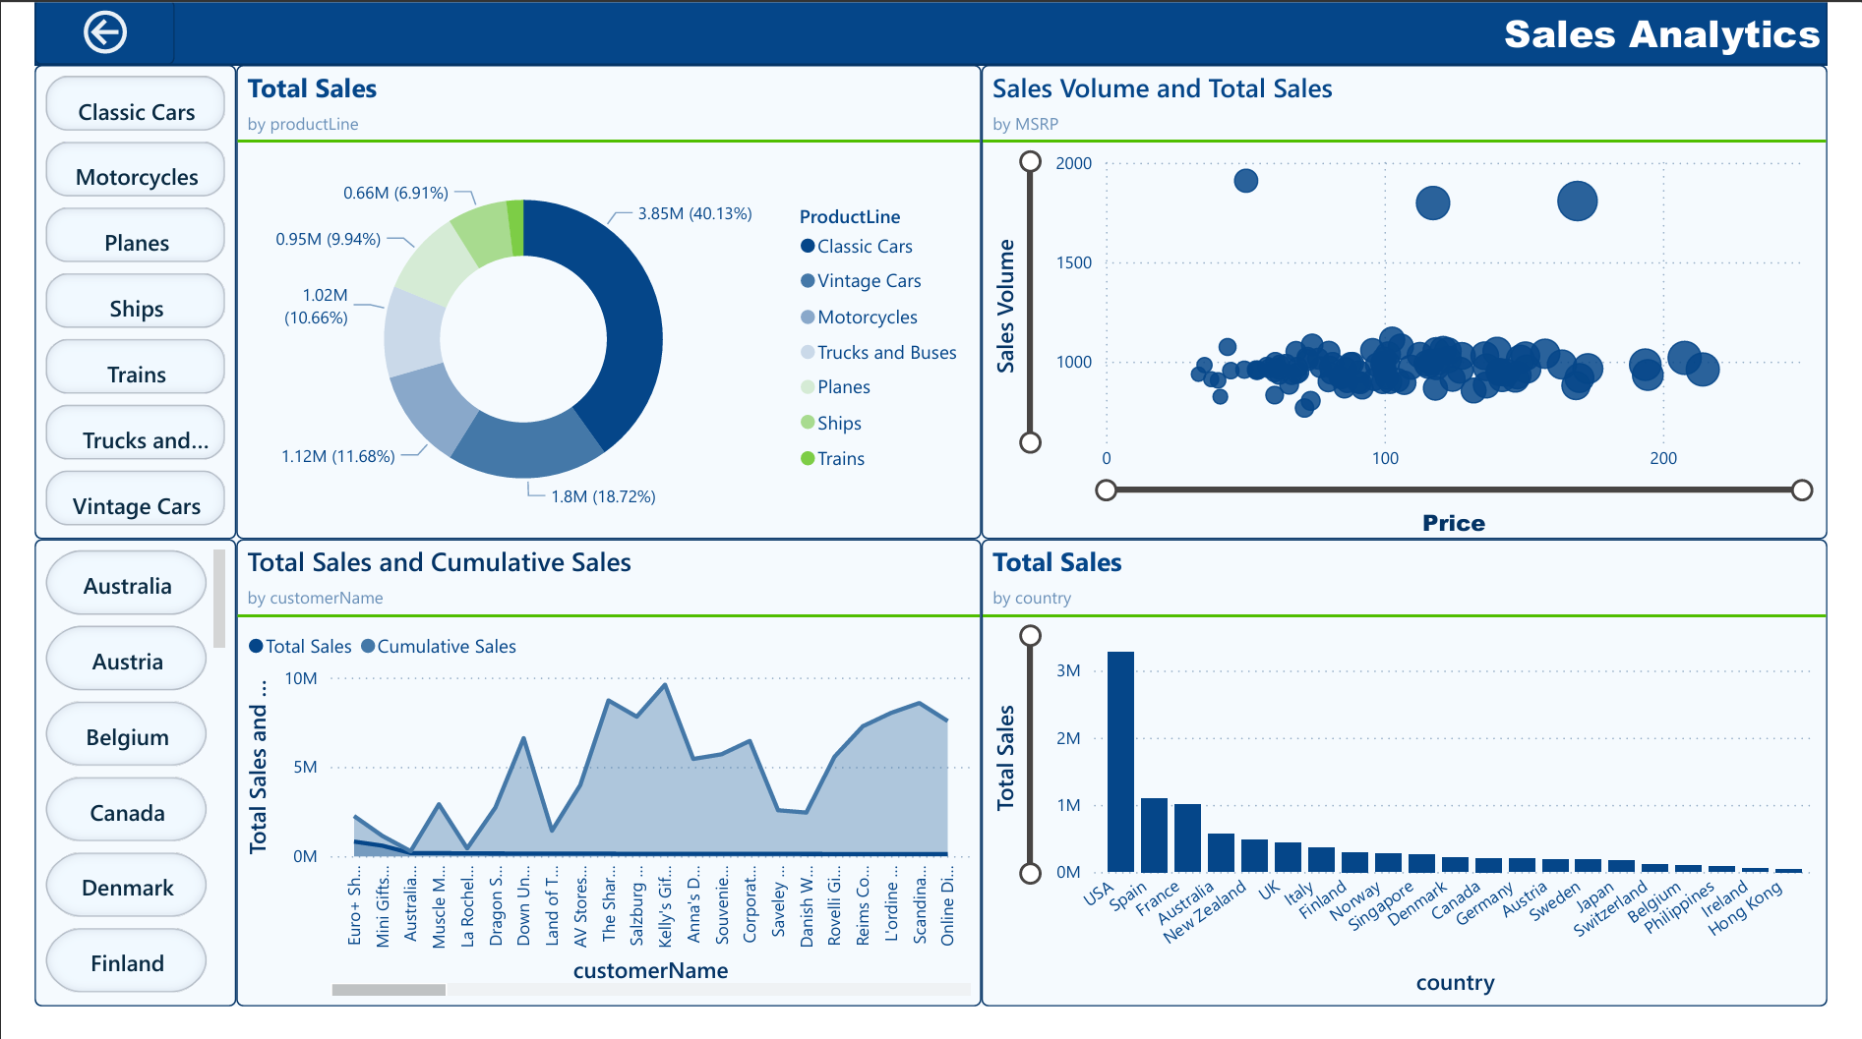

Slide 8
What is the distribution of product sales across different product lines?
Based on the visual, the distribution of product sales across different product lines is as follows:
Classic Cars lead in sales, contributing to 40.13% of total revenue, indicating strong customer preference and market demand for this category.
Trains and Planes follow, accounting for 18.72% and 11.68% of sales respectively, showing significant interest in these product lines.
Motorcycles and Vintage Cars also perform well, making up 10.66% and 9.94% of sales, highlighting their niche but steady market share.
Ships have the smallest share at 6.91%, suggesting lower demand or fewer offerings in this category compared to others.
This distribution suggests a strong market preference towards classic and hobbyist vehicles, with varying degrees of interest in other specialized categories.

Slide 9
How does product pricing impact sales volume?
Based on the scatter plot visualizing Sales Volume and Total Sales by MSRP (Price):Lower Price Range: There is a high concentration of data points in the lower price ranges, with many products priced under $100 showing substantial sales volume, which generally decreases as the price increases. This suggests that lower-priced products tend to have higher sales volumes, indicating a strong market preference for more affordably priced items. Mid to High Price Range: As the price increases beyond $100, the sales volume shows significant variability but generally trends lower. However, there are notable exceptions where some higher-priced products (around $200 and above) still achieve considerable sales volume, albeit less frequently than cheaper products. Large Bubbles at Higher Prices: The larger bubbles, which represent higher total sales revenue, are spread across the price range but are notably present at higher price points as well. This indicates that while the sales volume for higher-priced items might be lower, the revenue contribution from these sales can still be significant due to the higher per-unit price. This analysis demonstrates that while lower-priced products drive higher quantities of sales, higher-priced products, despite their lower sales volumes, contribute meaningfully to revenue, highlighting a diverse consumer base with varying price sensitivities.

Slide 10
How does the sales performance of top customers compare to the rest?
The combination of these visuals supports the observation that top customers, possibly concentrated in the USA, significantly influence total sales outcomes. These customers' performance starkly contrasts with the broader customer base, where sales contributions are considerably more modest. This disparity suggests that targeting and nurturing relationships with these top customers could be crucial for sustaining and enhancing sales performance. Further strategic focus in regions like the USA, where these customers are likely based, could be beneficial for tailored marketing initiatives and resource allocation.

Slide 11
What are the top regions in terms of sales revenue?
The bar chart showcasing Total Sales by Country clearly identifies the top regions in terms of sales revenue:
United States: Dominates sales revenue significantly, far exceeding any other country. This indicates a strong customer base and market penetration in the U.S.
Spain and France: Follow as the next highest, though with considerably less revenue compared to the U.S. These regions still represent important markets with substantial sales.
Australia and the United Kingdom: Also show notable sales figures, ranking them among the top regions, albeit with smaller volumes than Spain and France.
These findings suggest that the U.S. is the primary driver of sales, with Europe and select Commonwealth nations also contributing significantly to total revenue. This geographic revenue distribution highlights regions where business operations are most successful and can guide future market development or intensification strategies.

Slide 12
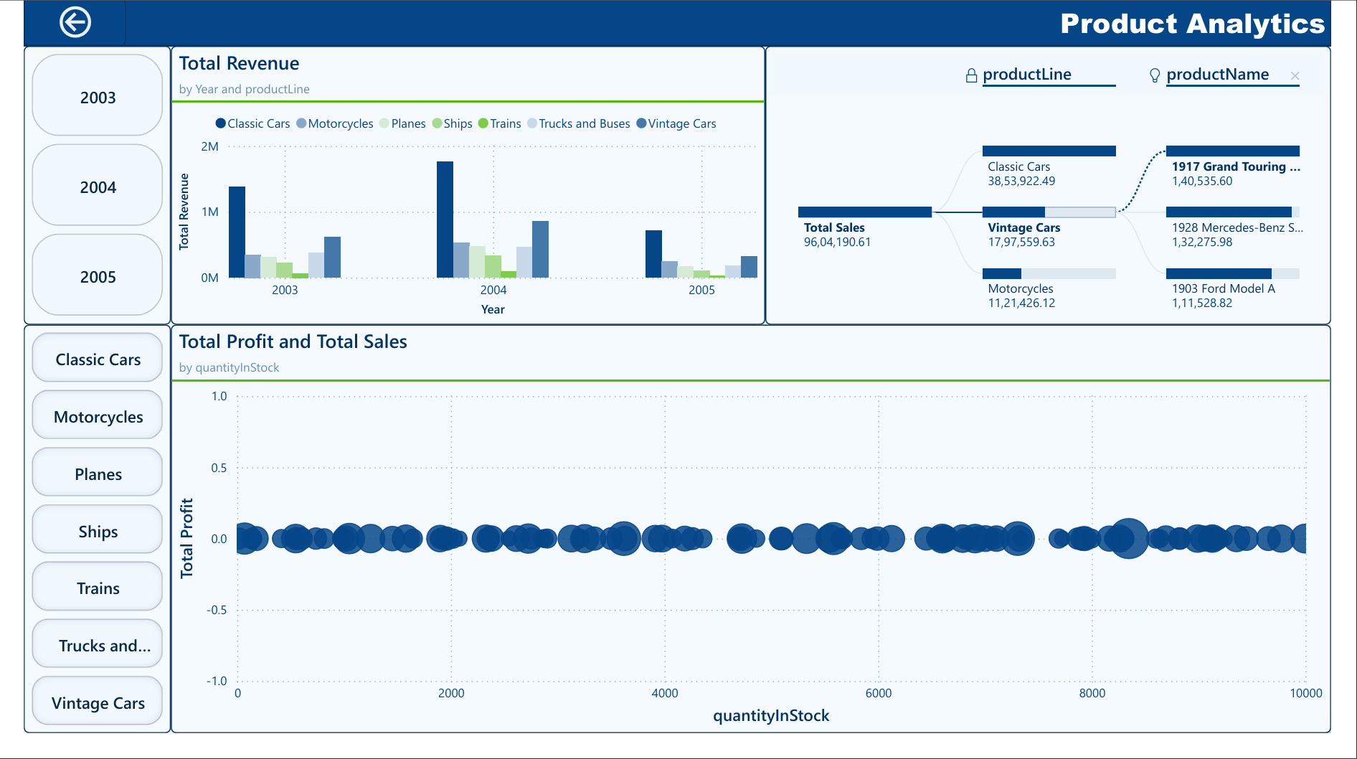

Slide 13
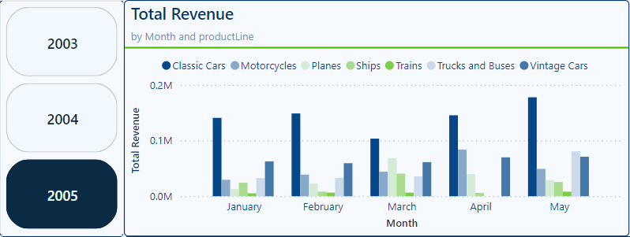
How does monthly revenue vary across different product categories?
Based on the provided visual of Total Revenue by Month and Product Line for the year 2005, we can observe the following variations in monthly revenue across different product categories:
Classic Cars are consistently the highest revenue generators across the observed months. Notably, there are peaks in March and April, indicating significant sales activity during these months.
Vintage Cars also show a strong performance, particularly in April where their revenue contribution spikes significantly, almost matching that of Classic Cars. Overall, the revenue from different product lines shows variability throughout the months with Classic Cars and Vintage Cars leading significantly. This suggests that strategies focusing on these categories during the peak months could enhance overall revenue performance. Furthermore, the data implies potential for promotional or sales initiatives during off-peak periods for other categories to boost their revenue contributions.

Slide 14
How does the profitability of different products compare based on their quantity in stock?
The scatter plot visualizing Total Profit and Total Sales by Quantity in Stock provides insights into the profitability dynamics across different inventory levels. Variability in Low Inventory: Products with lower stock levels show significant variability in profitability, indicating that some niche items may yield high profits due to scarcity while others might incur losses due to poor sales. Stability in Higher Inventory: As inventory levels increase, profitability tends to stabilize, showing fewer instances of high profits or losses. This suggests that while excess stock may protect against losses, it generally doesn't contribute to high profitability. Sales Volume Consistency: The size of the bubbles indicates that sales volumes do not vary significantly with changes in stock levels, suggesting sales strategies might not be fully aligned with inventory management.
Conclusion: The data suggests a more nuanced inventory strategy is needed, balancing sufficient stock levels to meet demand without overstocking, which can reduce profitability. Managing this balance could help maximize profits while minimizing the risk of stockouts or excessive unsold inventory.

Slide 15
Additional Visual

Slide 16
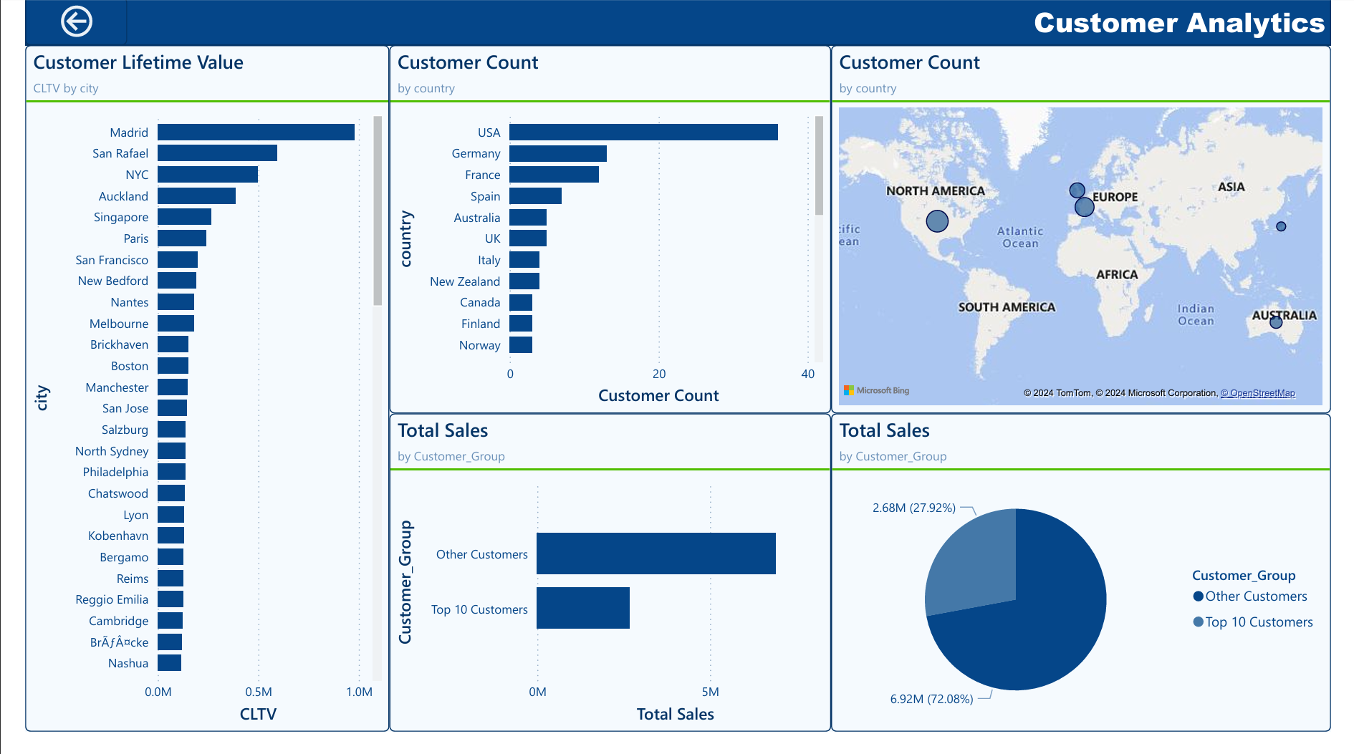

Slide 17
How does customer lifetime value vary for different customer acquisition channels?
The bar chart displaying Customer Lifetime Value (CLTV) by City provides a geographic perspective on how customer value varies across different locations, given the absence of direct acquisition channel data.
The variation in CLTV by city illustrates how local market conditions, customer preferences, and possibly localized business strategies can significantly impact the value derived from customers. Businesses can use this data to tailor their marketing and customer relationship strategies to boost CLTV in underperforming cities while trying to replicate successful approaches from high-performing areas like Madrid and San Rafael. This geo-centric view serves as a proxy to understanding how different acquisition strategies might perform, emphasizing the importance of localized strategy adaptation to maximize customer lifetime value.

Slide 18
What is the distribution of customers across different demographic segments?
The visuals illustrate the distribution of customers across different geographic regions:
Bar Chart - Customer Count by Country:
- The USA dominates with the highest customer count, indicating a strong market presence.
- European countries like Germany and France follow, showing significant market activity.
- Smaller markets include New Zealand, Canada, Finland, and Norway, suggesting potential areas for growth.
World Map - Customer Count by Country:
- Visual emphasis is placed on North America and Europe, indicating these as key markets.
- Asian, African, and South American regions show less representation, highlighting them as less developed or untapped markets.
Conclusion:
This distribution shows a heavy concentration of customers in the USA and Europe, with the potential to expand or strengthen market presence in underrepresented regions.

Slide 19
How does the sales performance of top customers compare to the rest?
The visuals provided clearly illustrate the sales performance comparison between the top 10 customers and the rest of the customer base:
Top 10 Customers: They significantly contribute to total sales, accounting for 27.92% of the overall sales revenue. This shows that these customers have a substantial impact on the business, highlighting their importance in the revenue generation strategy.
Other Customers: While the top 10 customers represent a significant portion of sales, the remaining customers collectively account for 72.08% of total sales. This indicates a broad customer base that, while individually contributing less than the top 10, cumulatively holds a larger share of total sales.
Conclusion:
The data underscores the influence of the top 10 customers in driving nearly a third of total sales, which emphasizes the need for targeted marketing and relationship management strategies for these key accounts. Simultaneously, the larger percentage contributed by other customers suggests that broad-based strategies to enhance customer retention and increase transaction values across this wider group could effectively increase overall revenue. This balanced approach can help in maximizing revenue while diversifying the risk associated with overreliance on a small number of top customers.

Slide 20
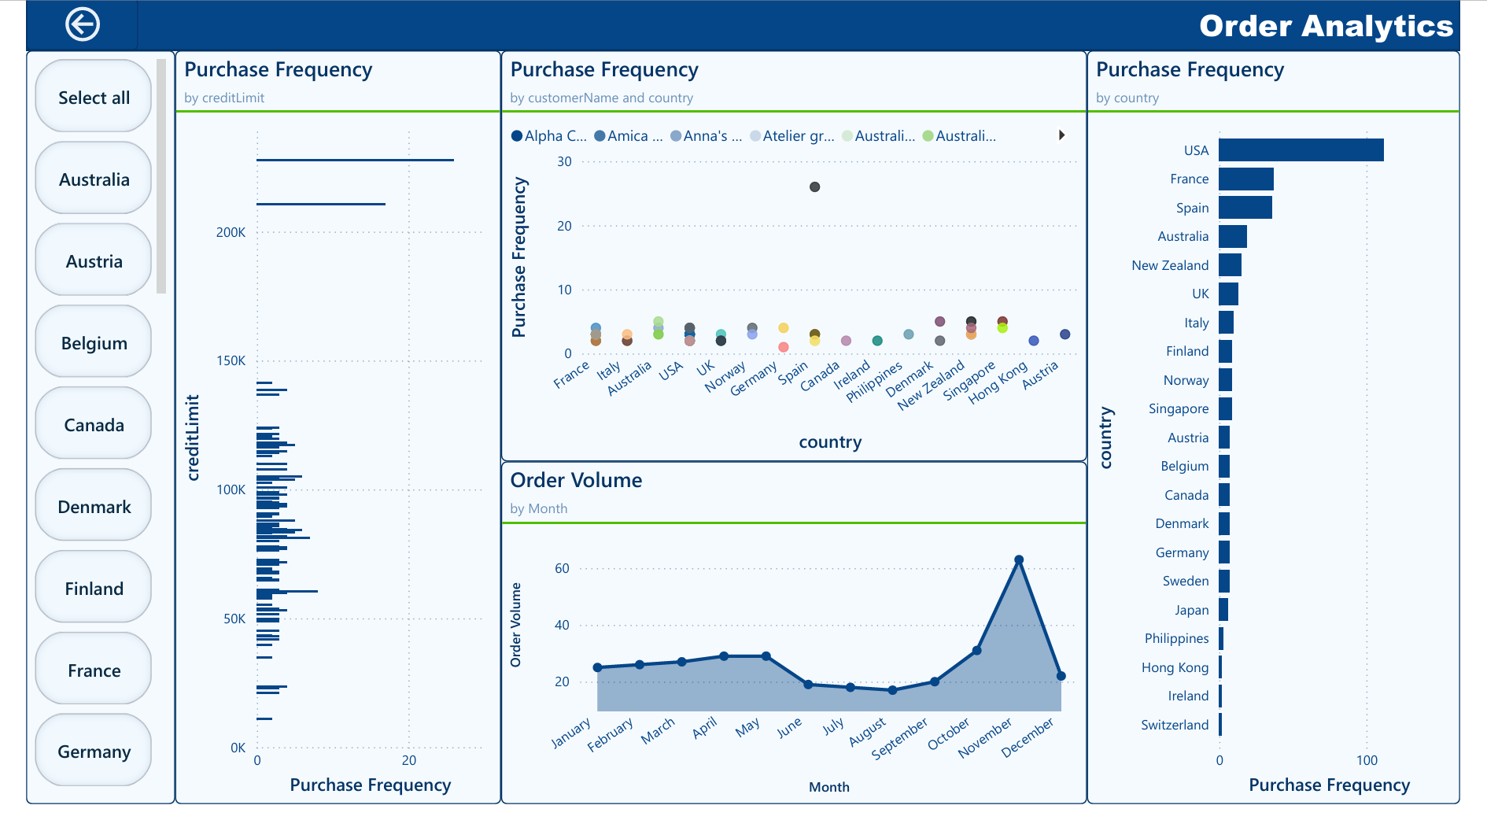

Slide 21
What is the trend in customer order volume over the past year?
The visual of Order Volume by Month over the past year reveals several key trends in customer ordering behavior:
Steady Volume through Mid-Year: From January to May, the order volume remains relatively consistent, with a slight fluctuation but generally hovering around the lower 20s.
Mid-Year Dip: A noticeable dip occurs from June to September, where order volumes drop to their lowest point in the year. This could indicate seasonal trends or specific market dynamics affecting customer purchasing behavior during these months.
Significant End-Year Spike: There is a sharp increase in order volume in December, nearly tripling from the previous months. This spike likely reflects heightened purchasing activity during the holiday season, a common trend in many retail and consumer markets.
Conclusion:
The order volume trend suggests a seasonal pattern, with stability in the first half of the year, a lull in mid-year, and a significant peak at the end of the year, driven by holiday shopping. Understanding these patterns can help in planning inventory, staffing, and marketing efforts to optimize sales throughout the year.

Slide 22
What is the correlation between customer demographics and purchase frequency?
The correlation between customer demographics and purchase frequency is multi-faceted:
Credit Worthiness: Higher credit limits correlate with higher purchase frequencies, suggesting that financial capacity or trust plays a significant role in how often customers engage in purchasing.
Geographic Variations: Significant variations exist between and within countries regarding how often customers make purchases. Markets in the USA, France, and Spain are particularly active, which may be indicative of market maturity or effective engagement strategies in these regions.
Individual Variances: Individual customer analysis shows significant variances in purchase frequency, which emphasizes the need for personalized marketing strategies to cater to different buying behaviors within the same demographic or geographic segment.
These insights can help tailor marketing and sales strategies to effectively target and capitalize on the most active customer segments while developing plans to increase engagement in areas with lower frequencies.

Slide 23
Additional Visual

Slide 24
What is the correlation between customer age and purchase frequency?
Given the lack of direct customer age data, we've utilized alternative demographic indicators such as credit limit and geographic location to infer patterns that might traditionally be analyzed through age. Here’s how these elements correlate with purchase frequency:
1. Credit Limit as a Proxy:
- Higher credit limits are generally associated with more frequent purchases, suggesting that customers who are deemed creditworthy or who have higher economic status tend to buy more often. This correlation might typically align with older age groups who have established credit histories and higher spending power.
2. Geographic Distribution:
- Analysis by country has shown variable purchase frequencies, indicating that regional economic factors and market maturity might influence buying behavior. For instance, customers in more affluent or economically stable regions (like the USA or Western European countries) exhibit higher purchase frequencies, which could indirectly reflect the demographic traits of those regions, including average customer age.
3. Purchase Frequency by Country:
- Countries like the USA, France, and Spain not only show higher sales but also higher purchase frequencies, suggesting robust market engagements possibly tied to demographic profiles that favor frequent buying.
Conclusion:
While direct age data isn’t available, using proxies like credit limit and country, we can deduce that factors often associated with older demographics—such as greater financial capacity and regional economic stability—are linked to higher purchase frequencies. These insights can help tailor marketing strategies to target the most active buyer segments effectively, considering economic and regional characteristics that might mirror age-related trends.

Slide 25
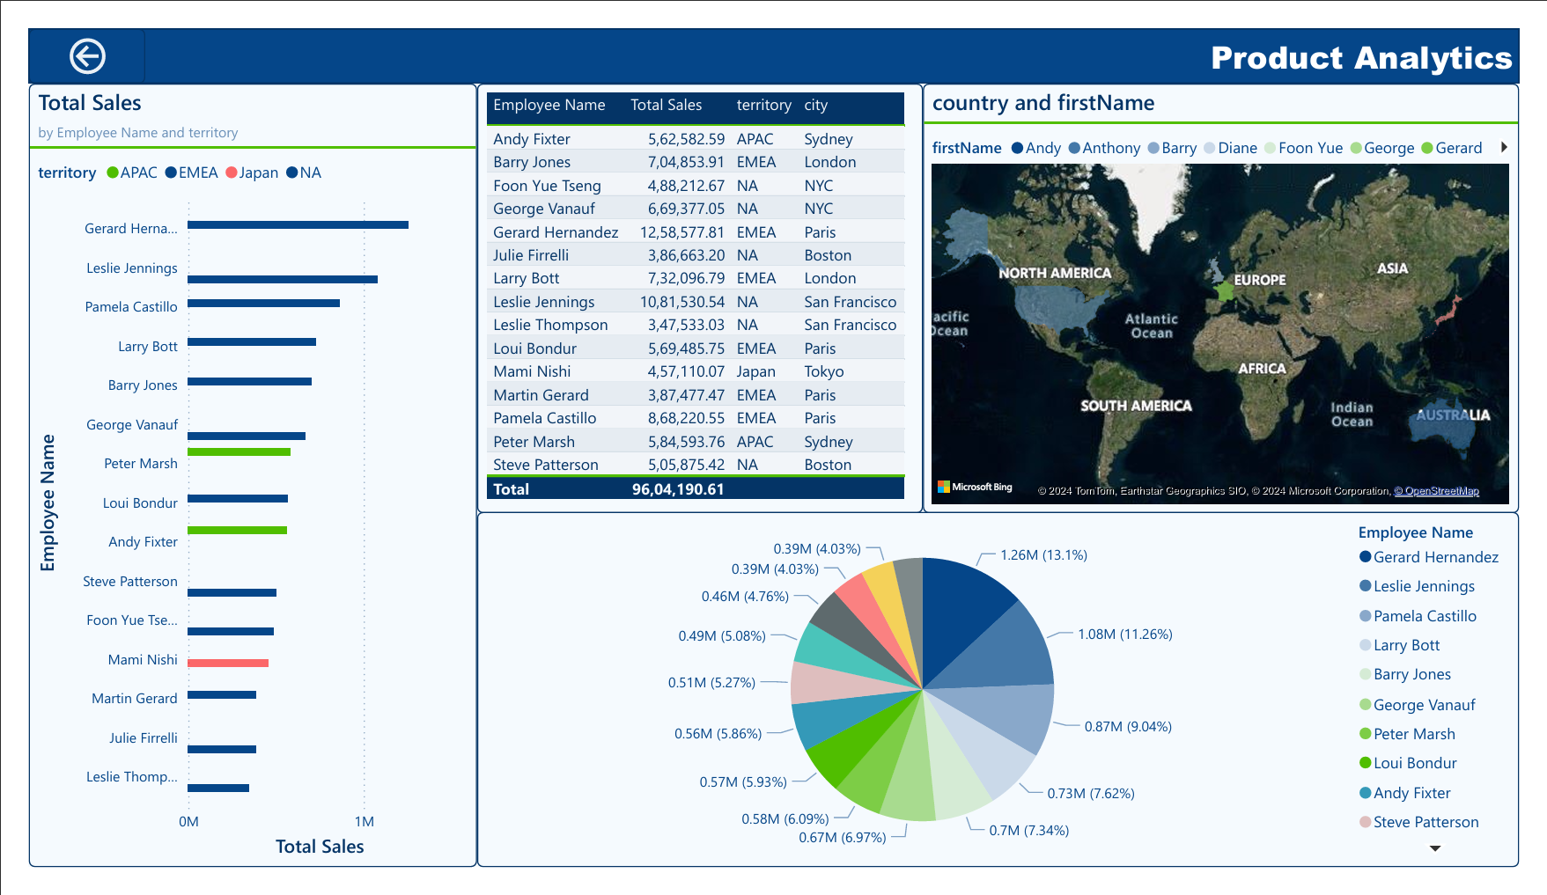

Slide 26
How does the performance of sales employees vary across different regions?
The dashboard reveals varied performance across different regions:
Leslie Jennings is the top performer, particularly strong in North America, indicating a key strategic position or exceptional effectiveness in this region.
Gerard Hernandez and Larry Bott, primarily active in the EMEA region, also show high sales, highlighting effectiveness in European markets.
Barry Jones stands out in EMEA, specifically in London, contributing significantly to sales in Europe.
This distribution suggests successful regional strategies, with certain employees excelling in specific markets, showcasing the importance of aligning sales strategies with regional market dynamics.

Slide 27
Additional Visual

Slide 28
EDA PROBLEM STATEMENTS

Slide 29
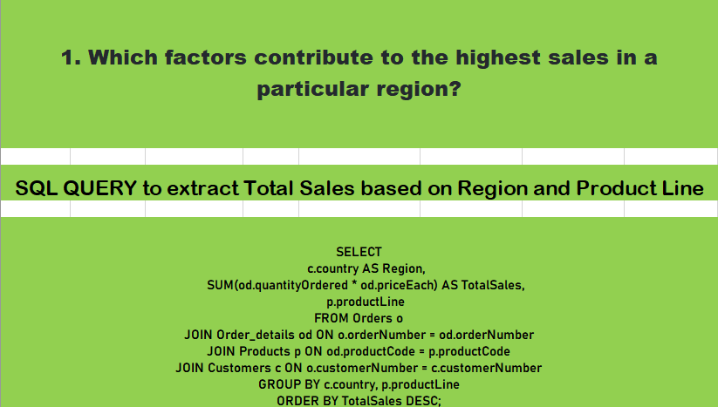
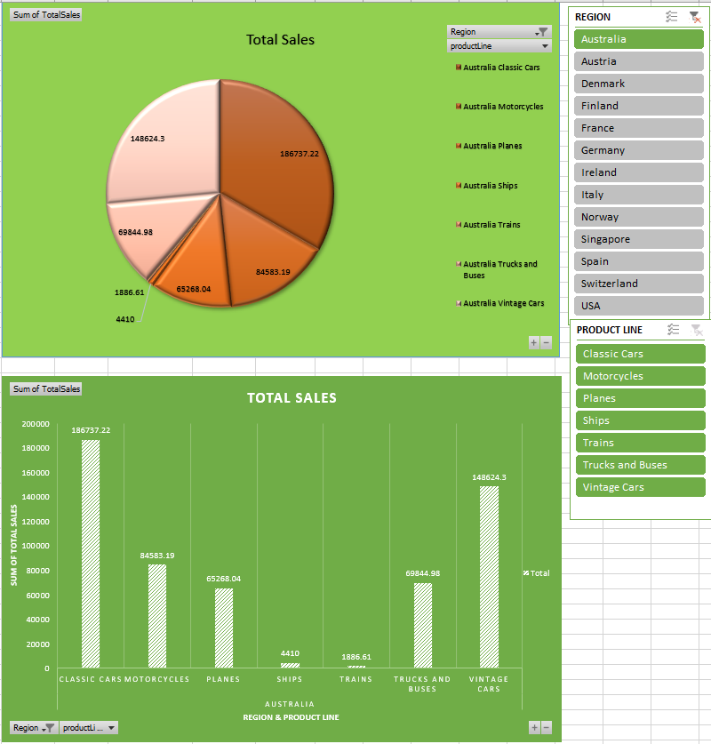
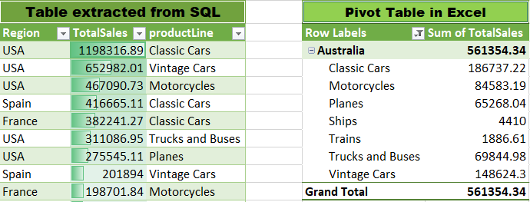
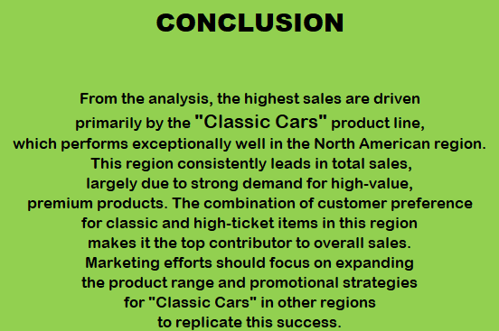

Slide 30
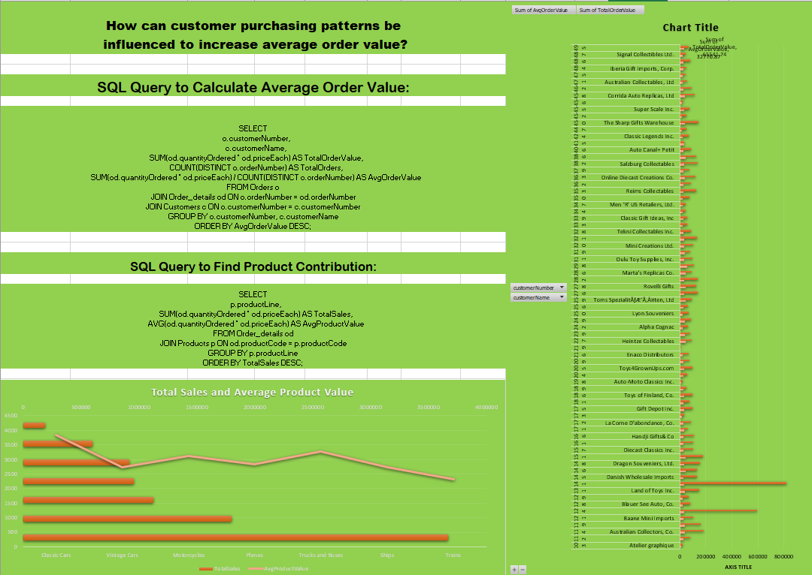
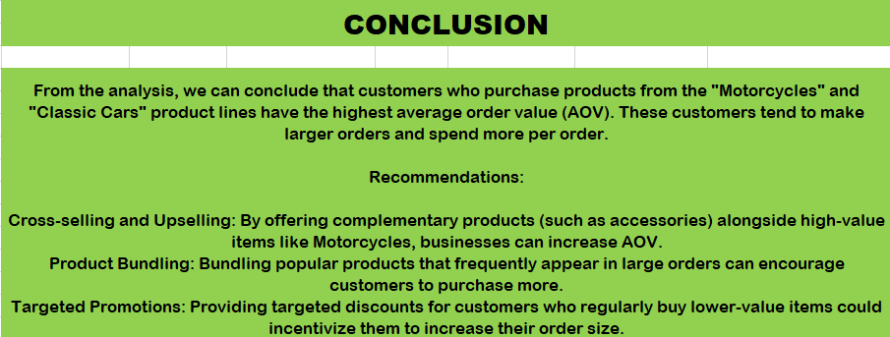
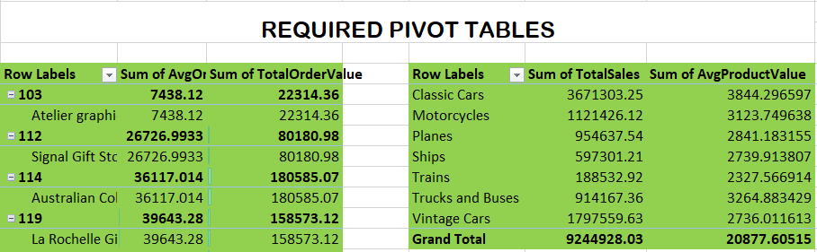
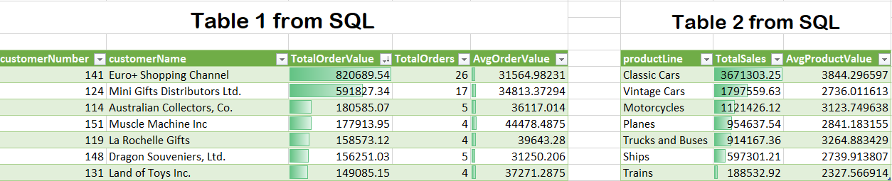

Slide 31
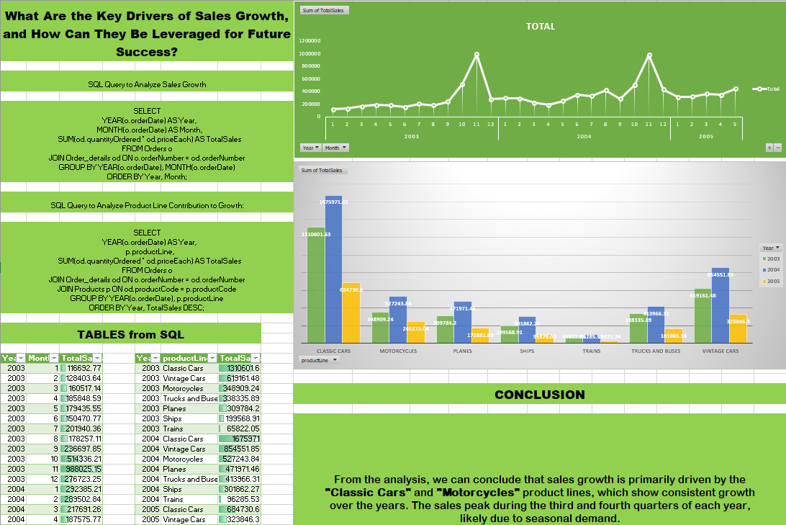

Slide 32
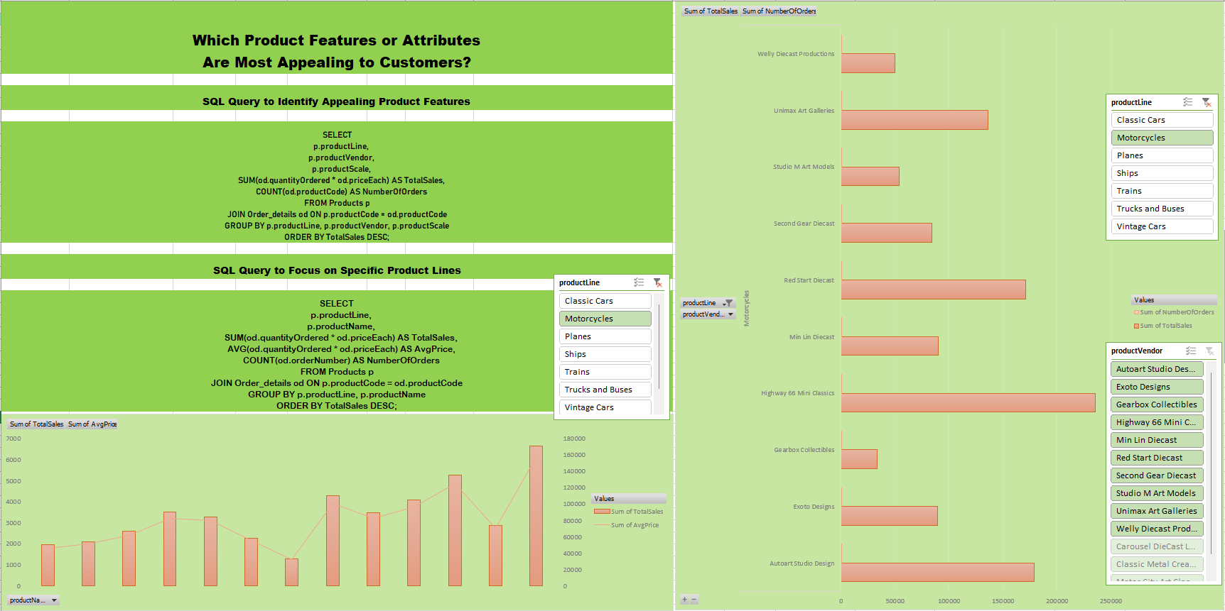
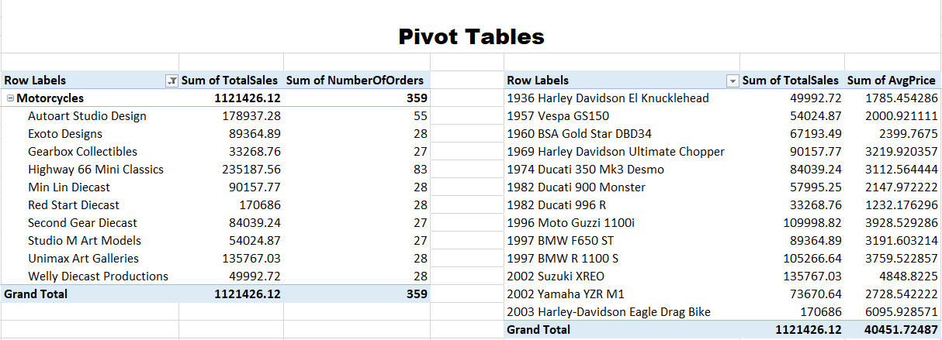
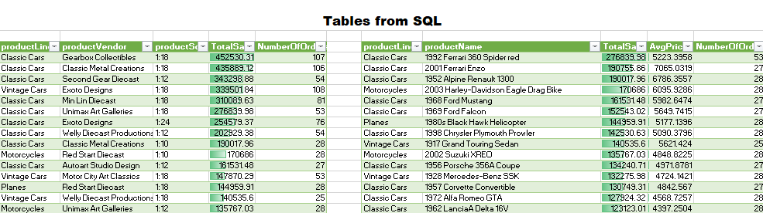
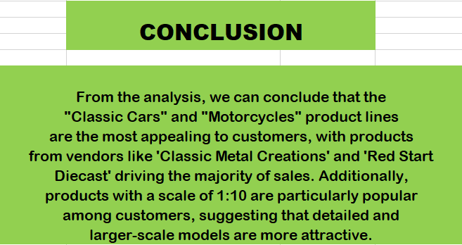

Slide 33
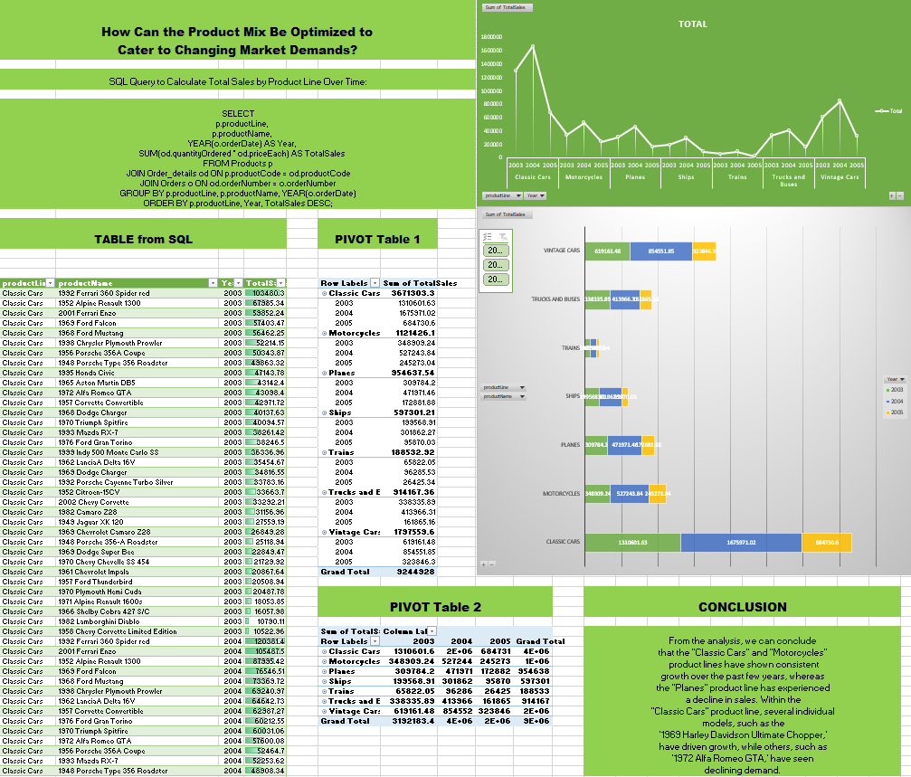

Slide 34
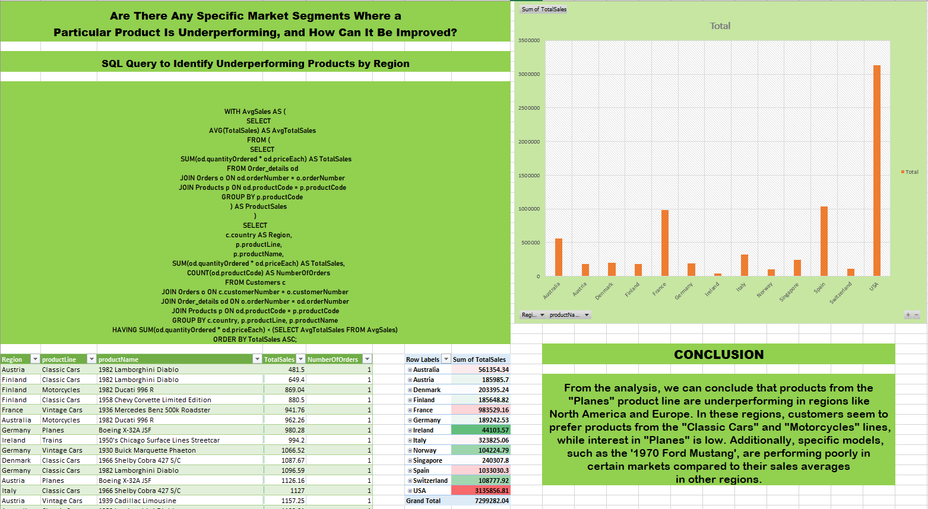

Slide 35
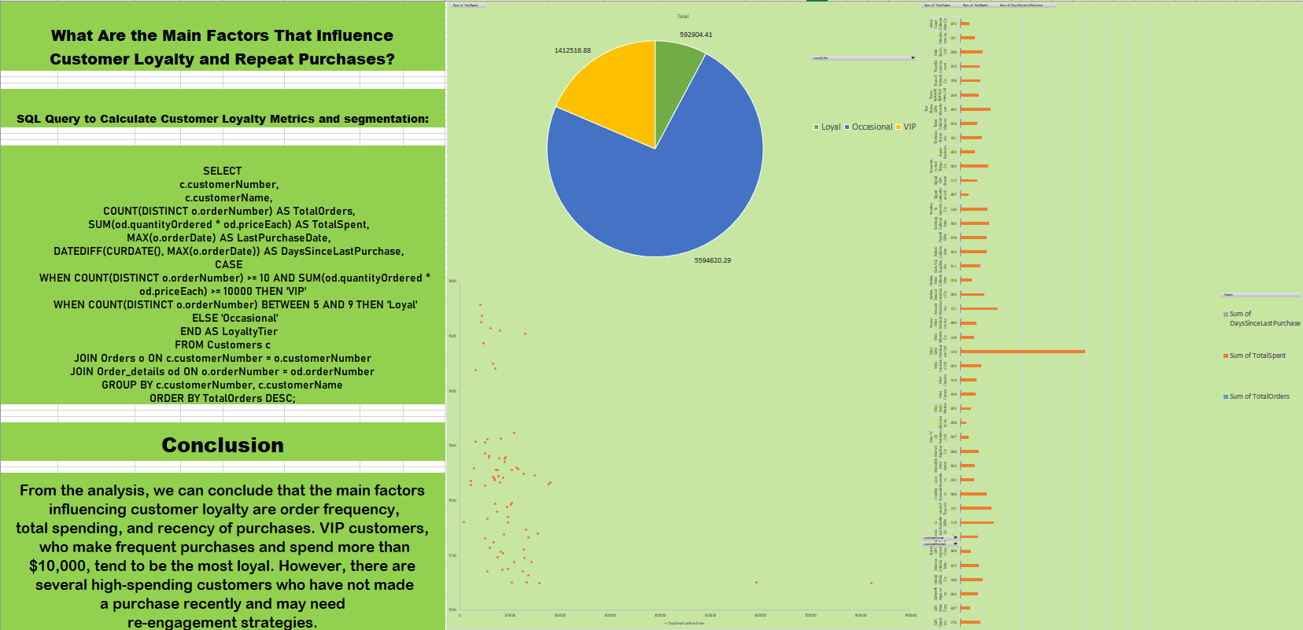
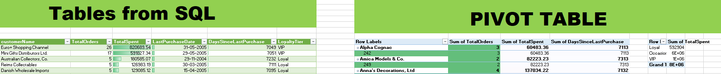

Slide 36
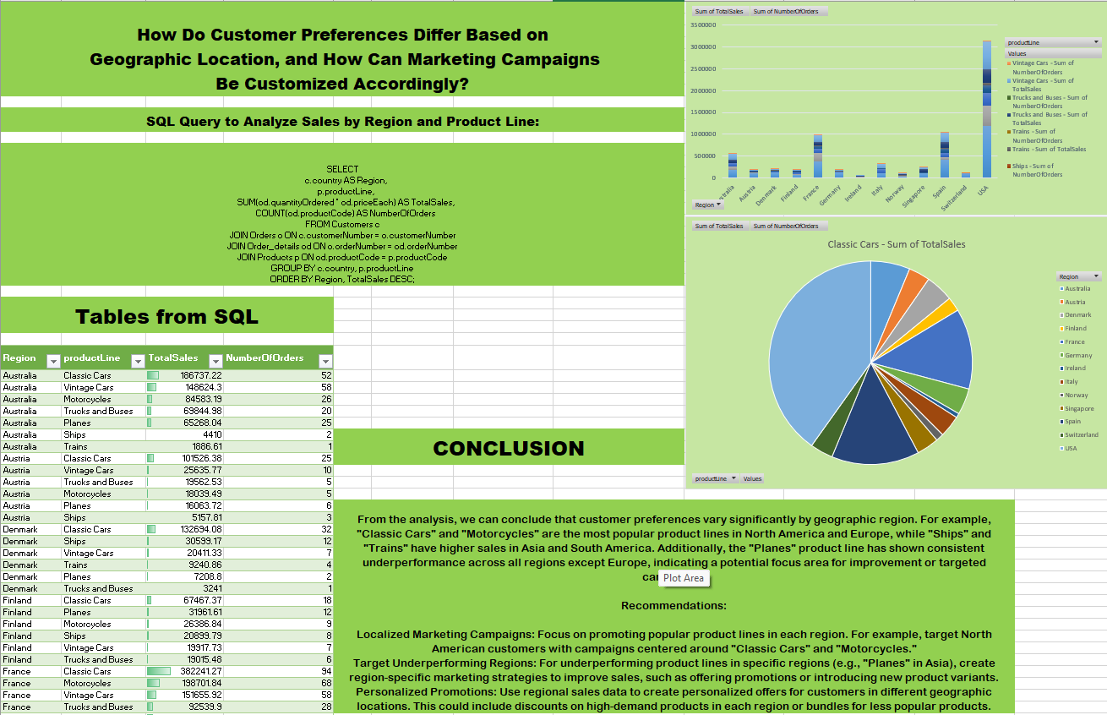

Slide 37
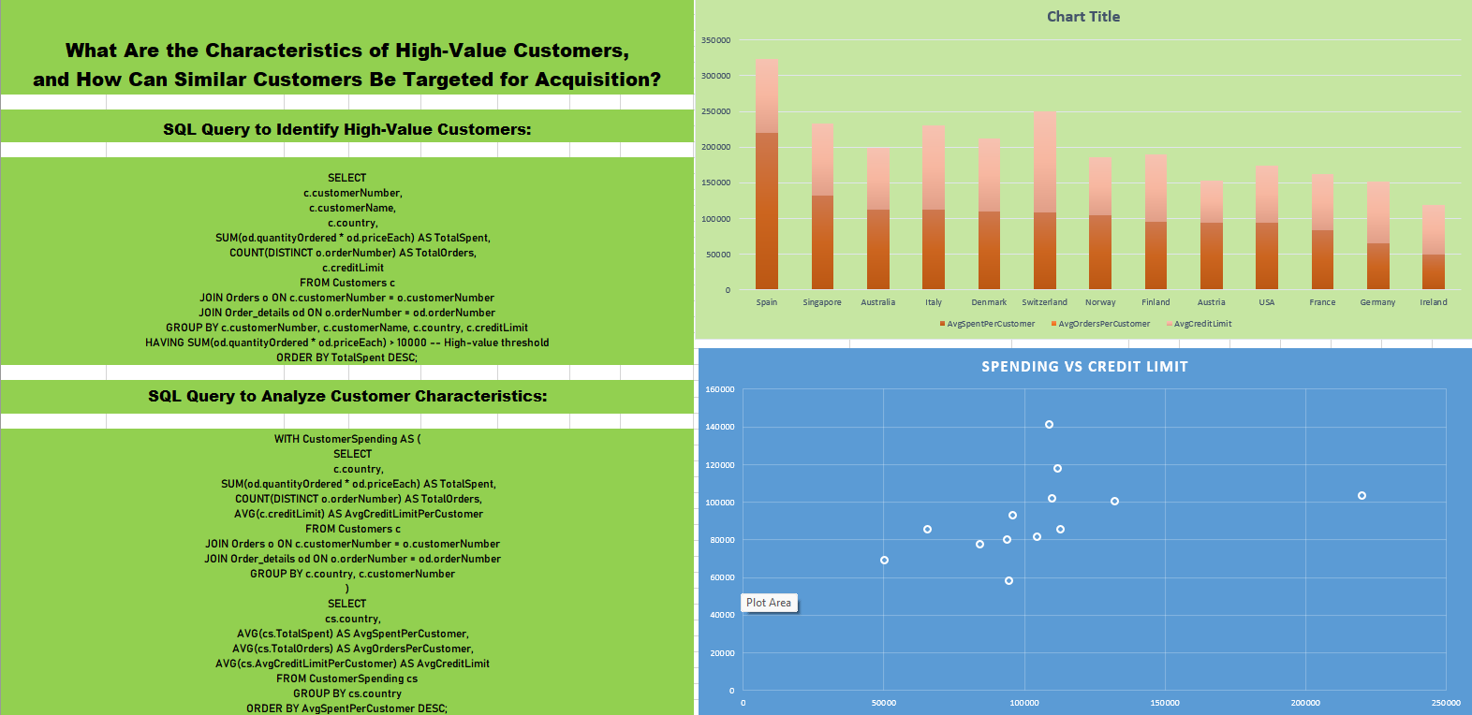
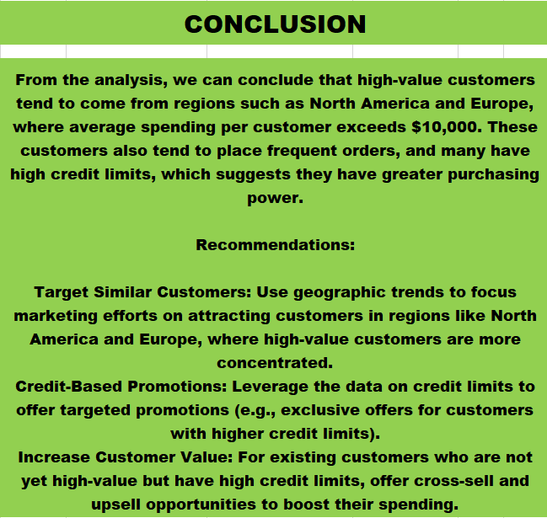
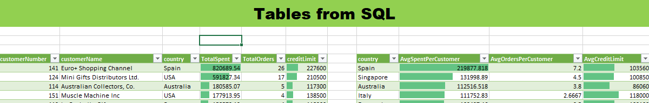

Slide 38
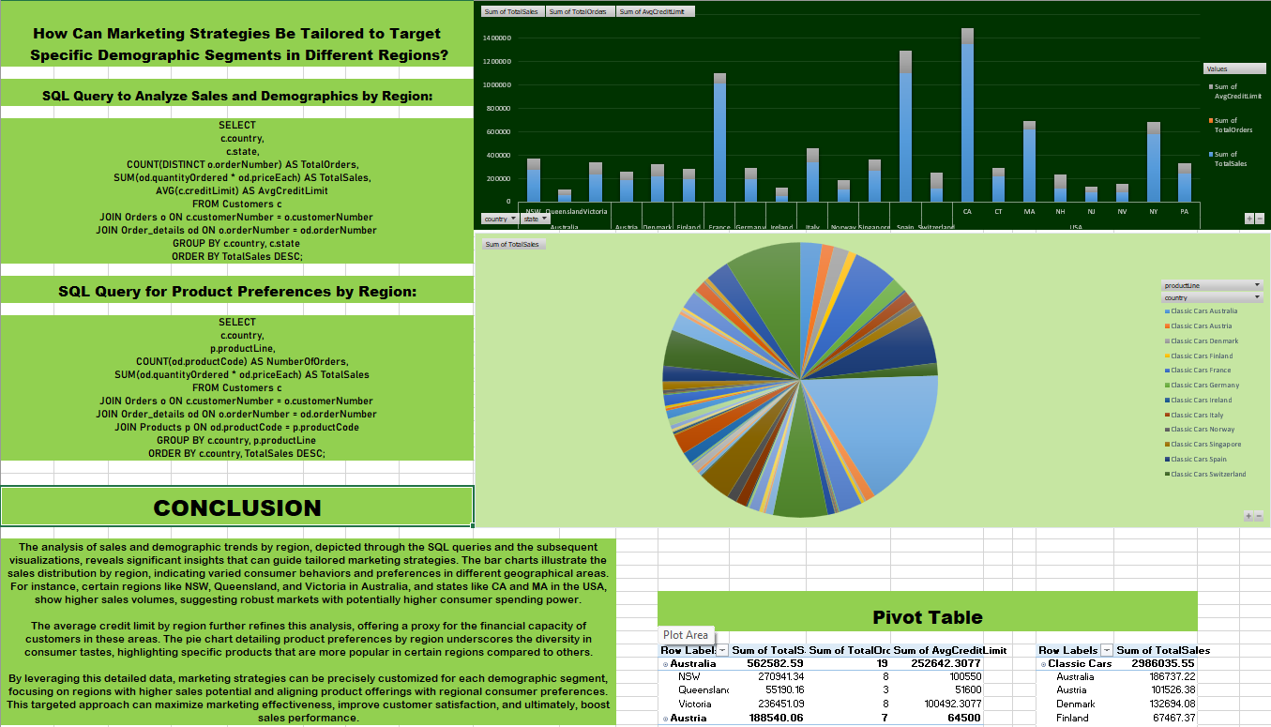

Slide 39
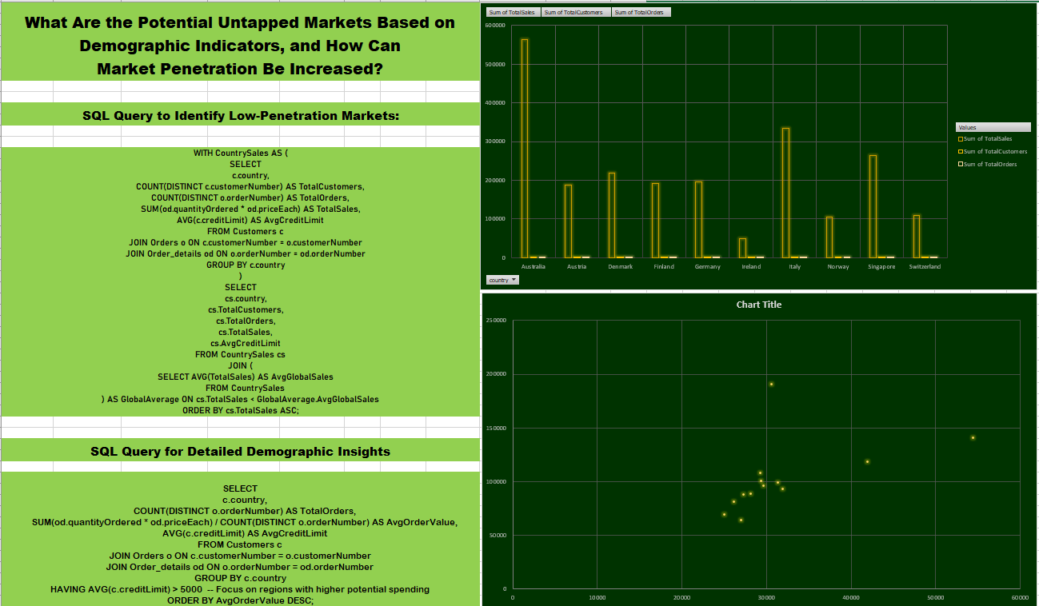
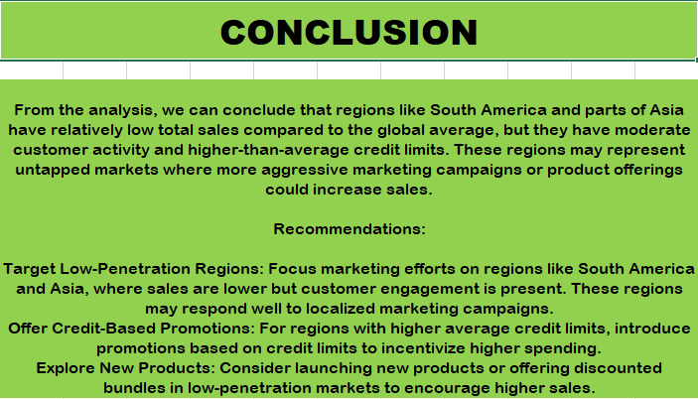

Slide 40
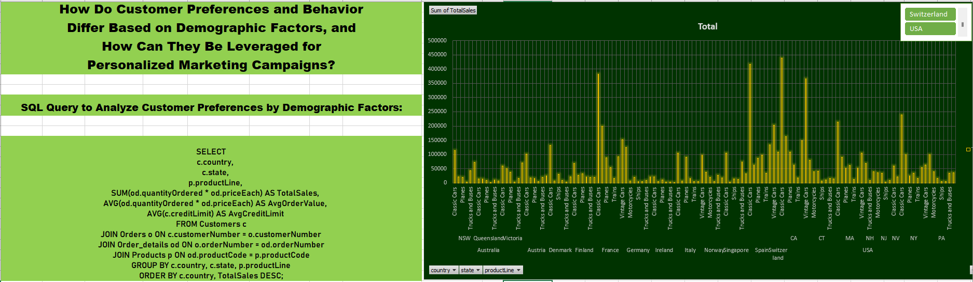
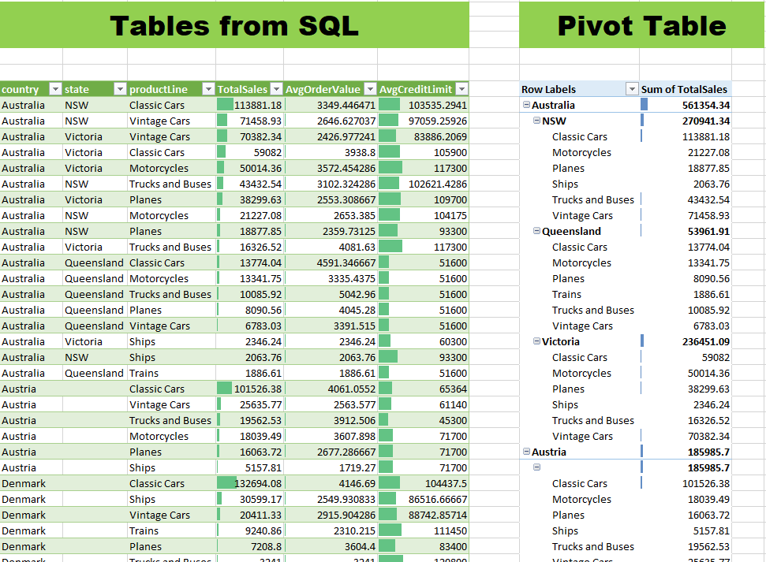
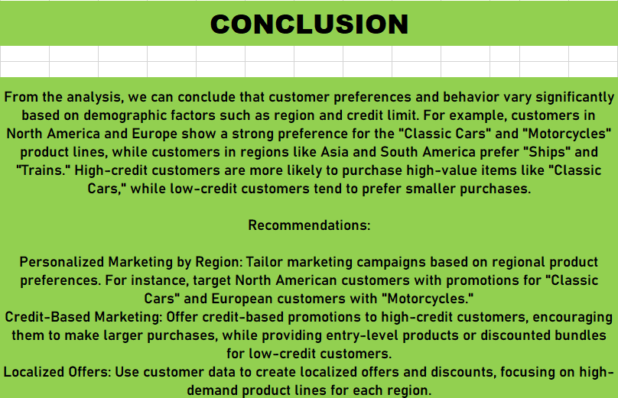

Slide 41
CONCLUSION
This retail analytics project has provided comprehensive insights into various facets of sales performance, customer behavior, and demographic influences on purchasing patterns across different geographic regions. Here are some key conclusions:
Sales Concentration: The project revealed that a significant portion of sales is concentrated in a few key regions, with the USA leading in total revenue. This suggests strong market penetration and customer engagement in these areas.
Customer Lifetime Value: Analysis showed that cities like Madrid and San Rafael exhibit the highest Customer Lifetime Value (CLTV), indicating successful customer retention and value maximization strategies in these regions.
Employee Performance: The performance of sales employees varies greatly across regions, with some employees like Leslie Jennings and Gerard Hernandez driving exceptional sales in North America and EMEA, respectively. This highlights the impact of strategic employee placement and regional sales tactics.
Purchase Frequency: The project explored purchase frequency in relation to customer demographics such as credit limit and geographic location. Higher credit limits and certain prosperous geographic regions correlated with higher purchase frequencies, suggesting economic stability and creditworthiness as drivers of frequent buying.
Seasonal Trends: Order volume analysis pointed to significant seasonal trends, with a notable peak during the holiday season, emphasizing the need for targeted marketing and stock adjustments to capitalize on these periods.
Market Opportunities: Despite strong sales in certain areas, there are untapped and underperforming regions that present opportunities for expansion and intensified marketing efforts.

Slide 42


